Slide 1

Defensive Security Project
by: Roy / Deb / Josh / Chuk

Slide 2
Table of Contents
This document contains the following resources:
Monitoring Environment
Attack Analysis
Project Summary & Future Mitigations

Slide 3

Monitoring Environment
‹#›

Slide 4
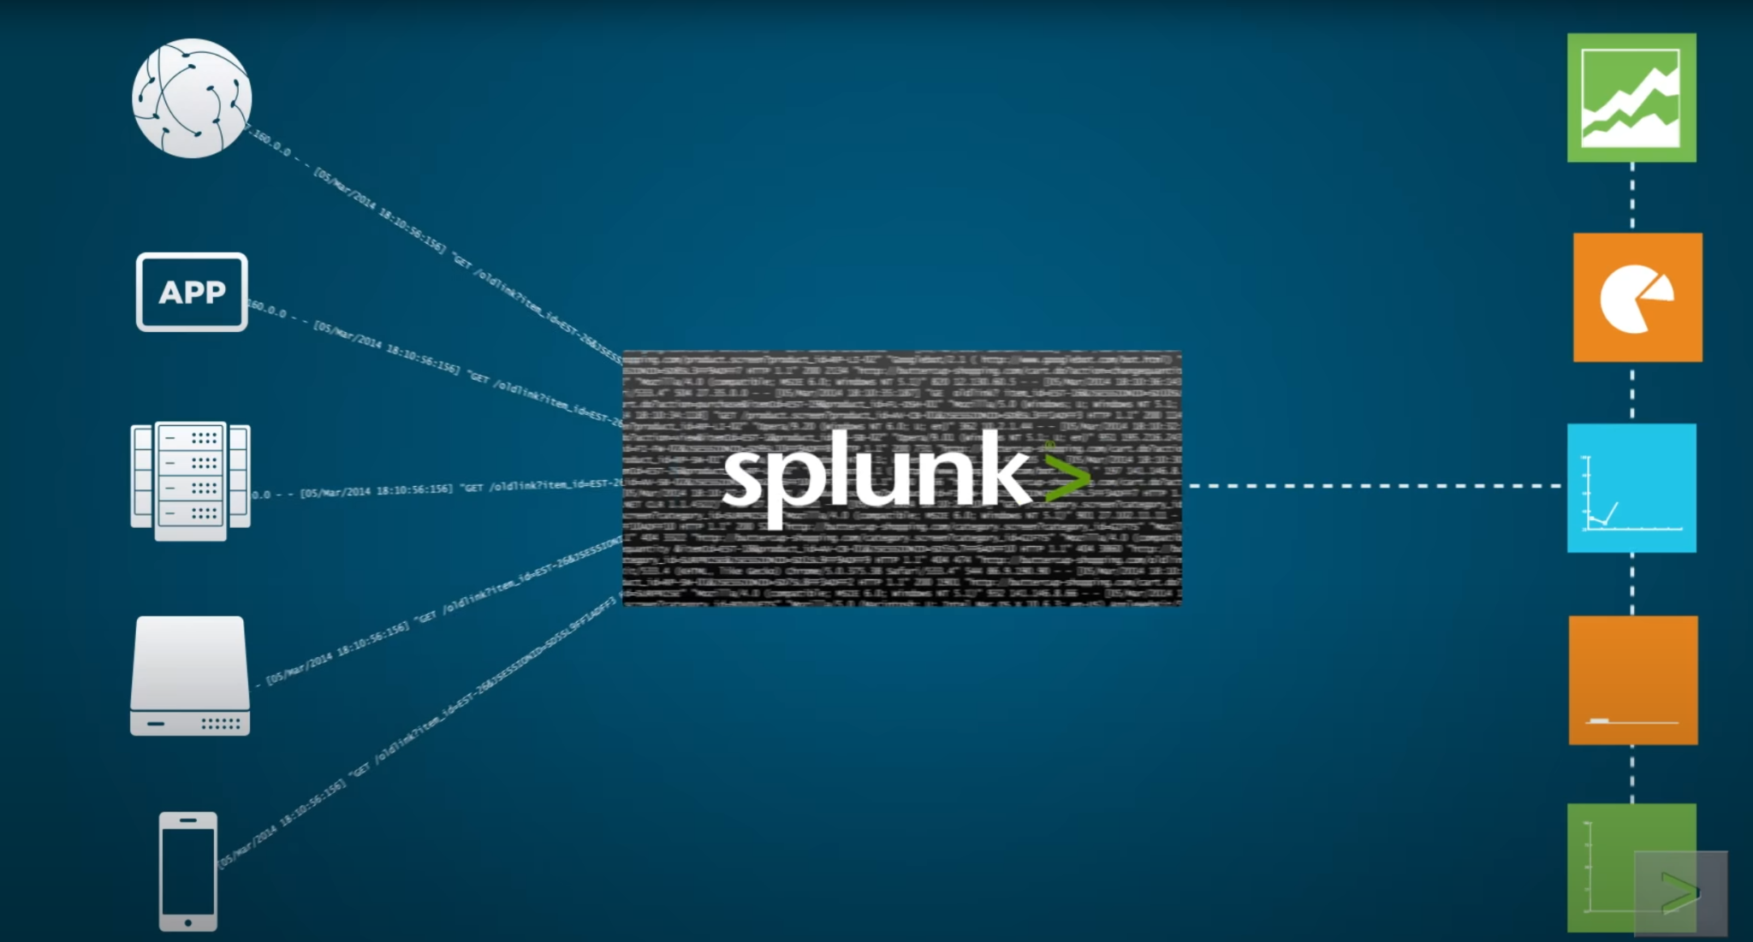
Scenario
VSI is a company that designs virtual-reality programs for businesses.
There have been rumors that a rival company, JobeCorp, may carry out cyberattacks to harm VSI's operations.
As SOC analysts, we have been given the responsibility of using Splunk to keep a watch for any potential attacks on VSI's systems and applications.
Our monitoring assignments at VSI include:
-An administrative webpage located at https://vsi-corporation.azurewebsites.net/
-An Apache web server that hosts the webpage
-A Windows operating system that supports many of VSI's back-end functions
The networking team has provided us with past log data to help us establish norms, generate reports, set alerts, and create dashboards to safeguard VSI against any potential attacks by JobeCorp.

Slide 5
Website Monitoring
‹#›

Slide 6
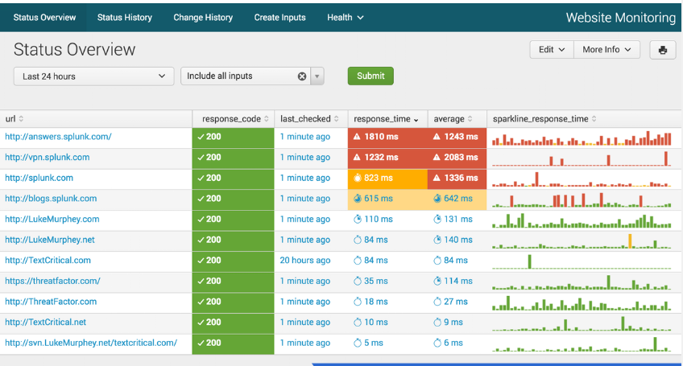
Website Monitoring- Summary
Monitor websites to detect downtime and performance problems. This app uses modular input that can be setup easily then works to protect, prevent and perfect systems.

Slide 7
Website Monitoring
[Scenario that illustrates benefit of add-on app.]
With Website monitoring you get accurate website performance updates through intelligent reports and alerts. This add on aims to protect, prevent and perfect.
Protection: effective website monitoring will alert you as problems occur in real time. You’ll know the moment your website crashes or a data breach compromises vital user information so you can take immediate action.
Prevention: you’ll have strategic systems in place to guide you and help avert as you maintain website performance.
Perfection: continuous improvement is one of the most subtle benefits of website monitoring. As you check for breaches and other security defects, you’ll keep developing your website as you go, improving the user experience, and impressing your clients.

Slide 8
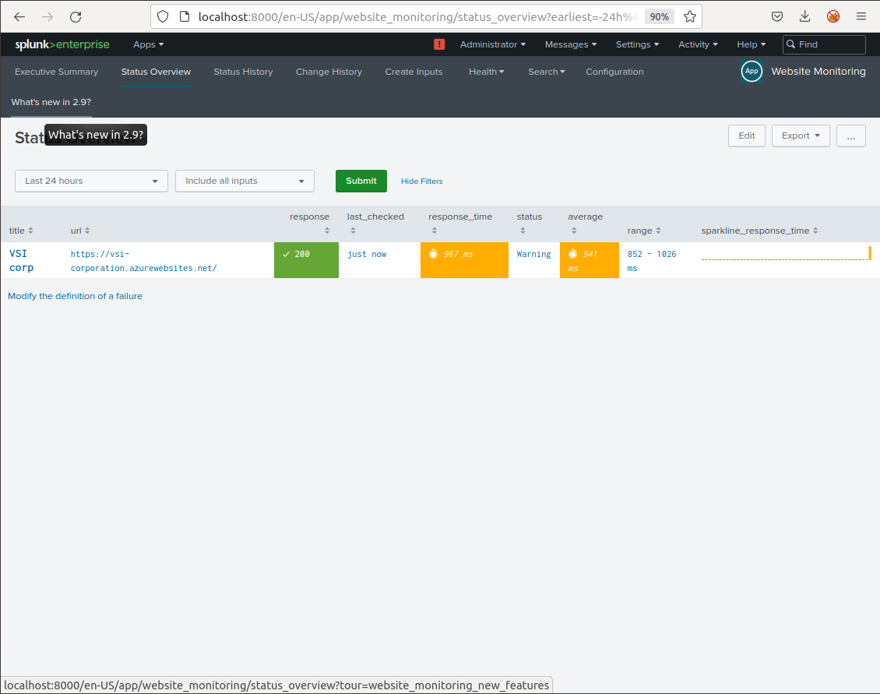
Website Monitoring

Slide 9
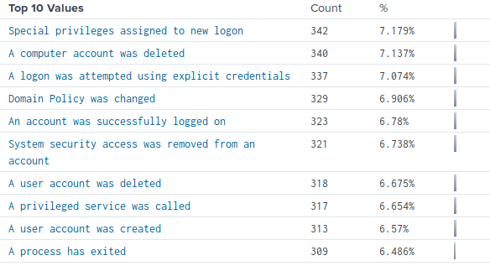
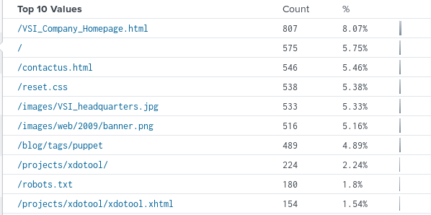
Logs Analyzed
Windows Logs
Apache Logs
1
2
The windows logs given to us were full of events around user actions including log in attempts, password resets and account deletion.
The apache logs contained information regarding traffic around the VSI website.

Slide 10
Windows Logs
‹#›

Slide 11
Reports—Windows
Designed the following Reports:
Report Name | Report Description
Signature / Signature IDs | Show the ID number associated with the specific signature for Windows activity
Severity Levels | Severity levels of the Windows logs being viewed
Success & Failure of Windows Activities | Provides a comparison between the success and failure of Windows activities.

Slide 12
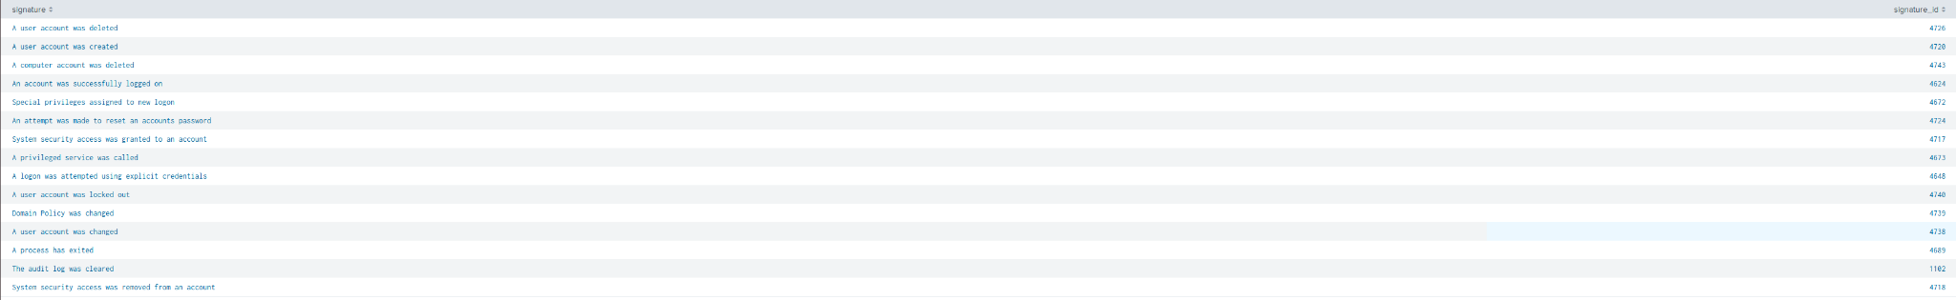
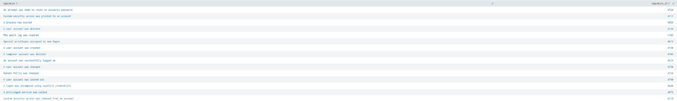
Images of Reports—Windows
Signature / Signature IDs Normal Data
Signature / Signature IDs Suspected Attack Data

Slide 13
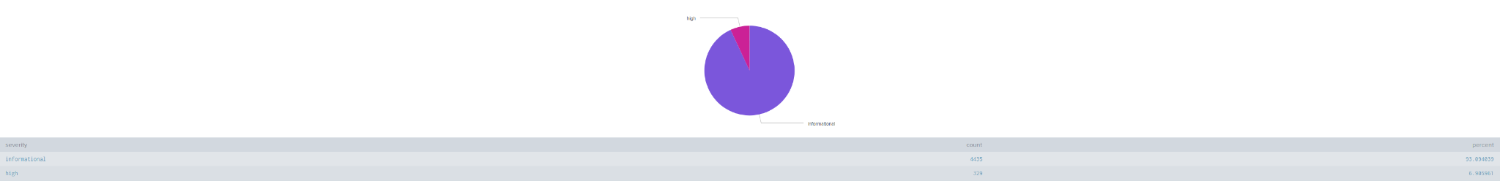
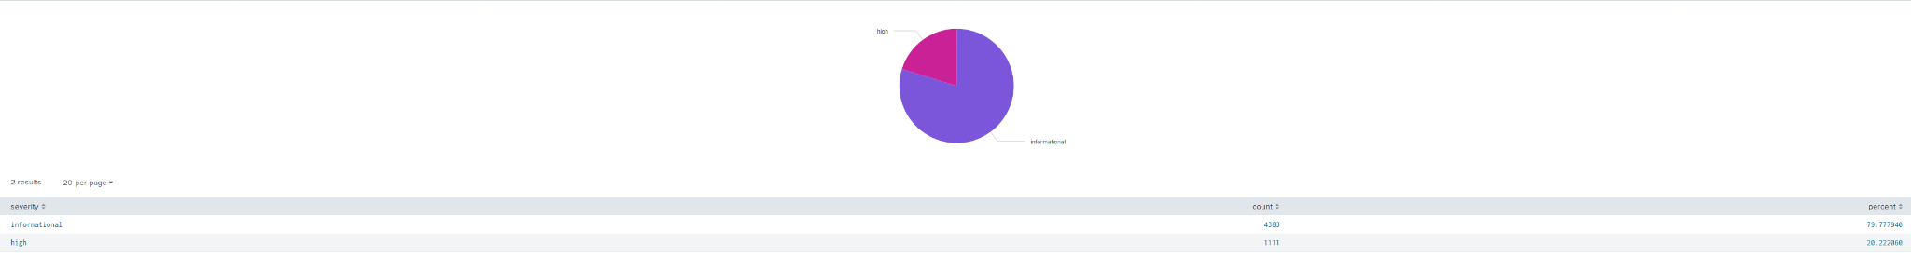
Images of Reports—Windows
Severity Levels
Normal Data
Severity Levels
Suspected Attack Data

Slide 14
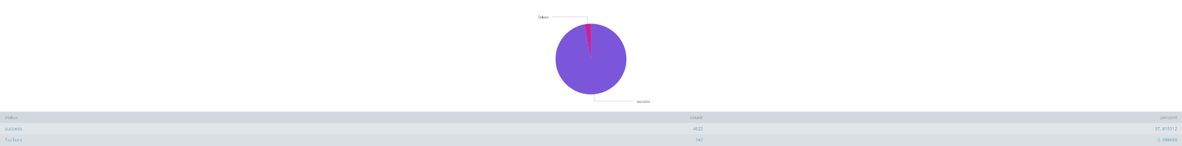
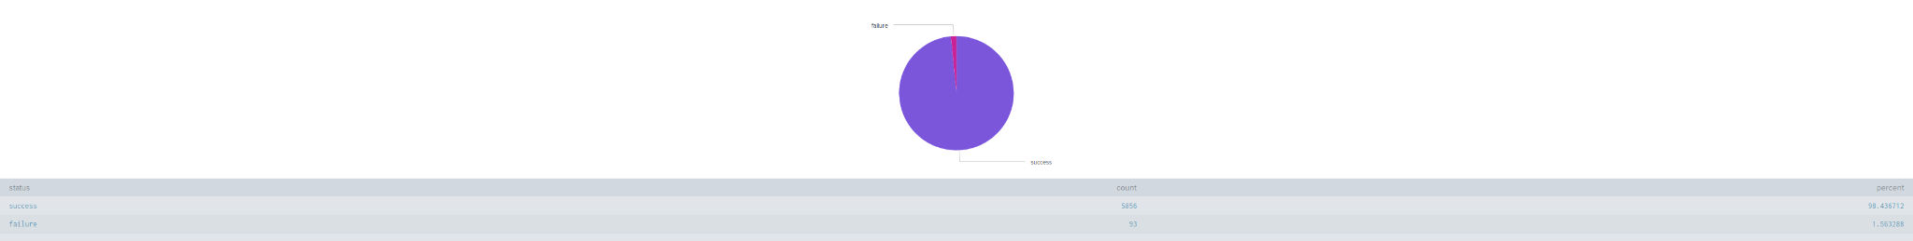
Images of Reports—Windows
Success & Failure of Windows Activities
Normal Data
Success & Failure of Windows Activities
Suspected Attack Data

Slide 15
Alerts—Windows
Designed the following alerts:
Alert Name | Alert Description | Alert Baseline | Alert Threshold
Failed Windows Activity Alert | This Alert will trigger when our system detects a high volume of failed windows activities within a 1 hour period |  | Greater than 12 events within the hour
After inspecting the baseline data for Windows activities, We found that the highest number of events was no greater than 10 events per hour, We feel a threshold of anything greater than 12 events within the hour to trigger an alert will be adequate.

Slide 16
Alerts—Windows
Designed the following alerts:
Alert Name | Alert Description | Alert Baseline | Alert Threshold
High Volume of Logins | This Alert will trigger when our system detects a high volume of user logins within a 1 hour period |  | Greater than 26 events within the hour.
After inspecting the baseline data for Successful Logins, We found that the highest number of events was no greater than 21 events per hour, We feel a threshold of anything greater than 26 events within the hour to trigger an alert will be adequate without producing too many false positive alerts.

Slide 17
Alerts—Windows
Designed the following alerts:
Alert Name | Alert Description | Alert Baseline | Alert Threshold
High Volume of Deleted User Accounts | This Alert will trigger when our system detects a high volume of user accounts being deleted within a 1 hour period. |  | Greater than 27 events within the hour.
After inspecting the baseline data for Deleted Users, We found that the highest number of events was no greater than 22 events per hour, We feel a threshold of anything greater than 27 events within the hour to trigger an alert will be adequate without producing too many false positive alerts.

Slide 18
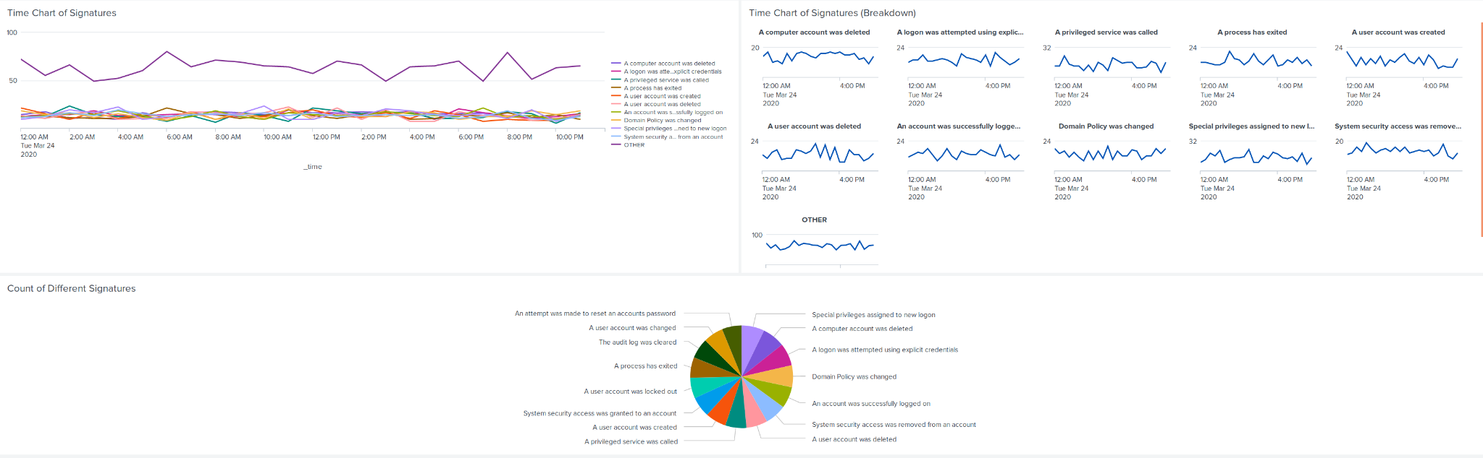
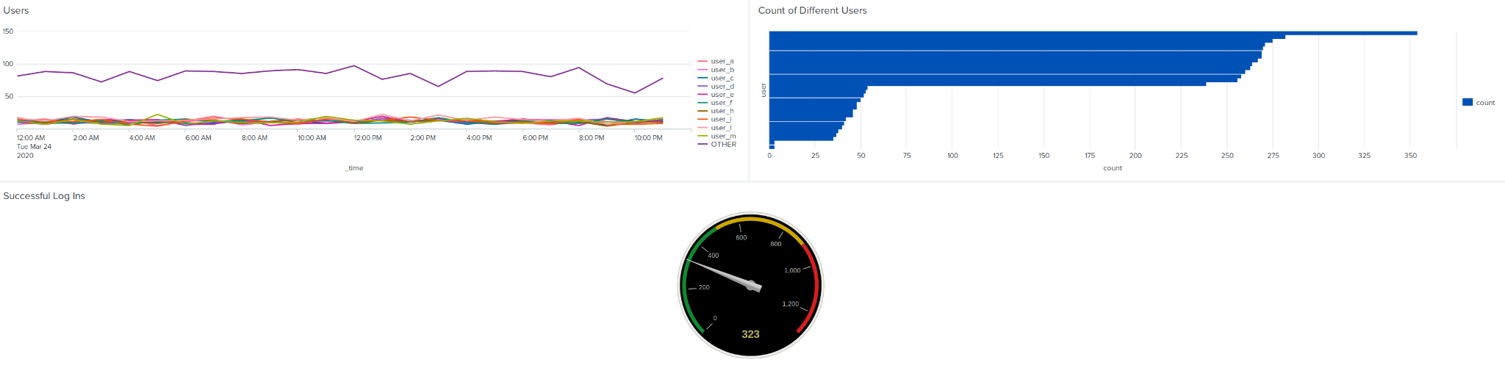
Dashboards—Windows (Normal Data)

Slide 19
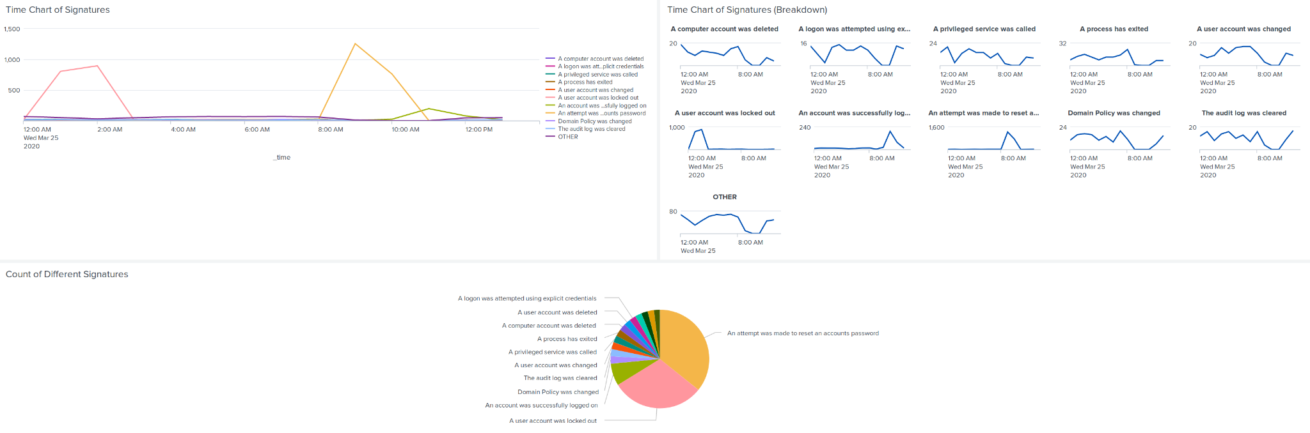
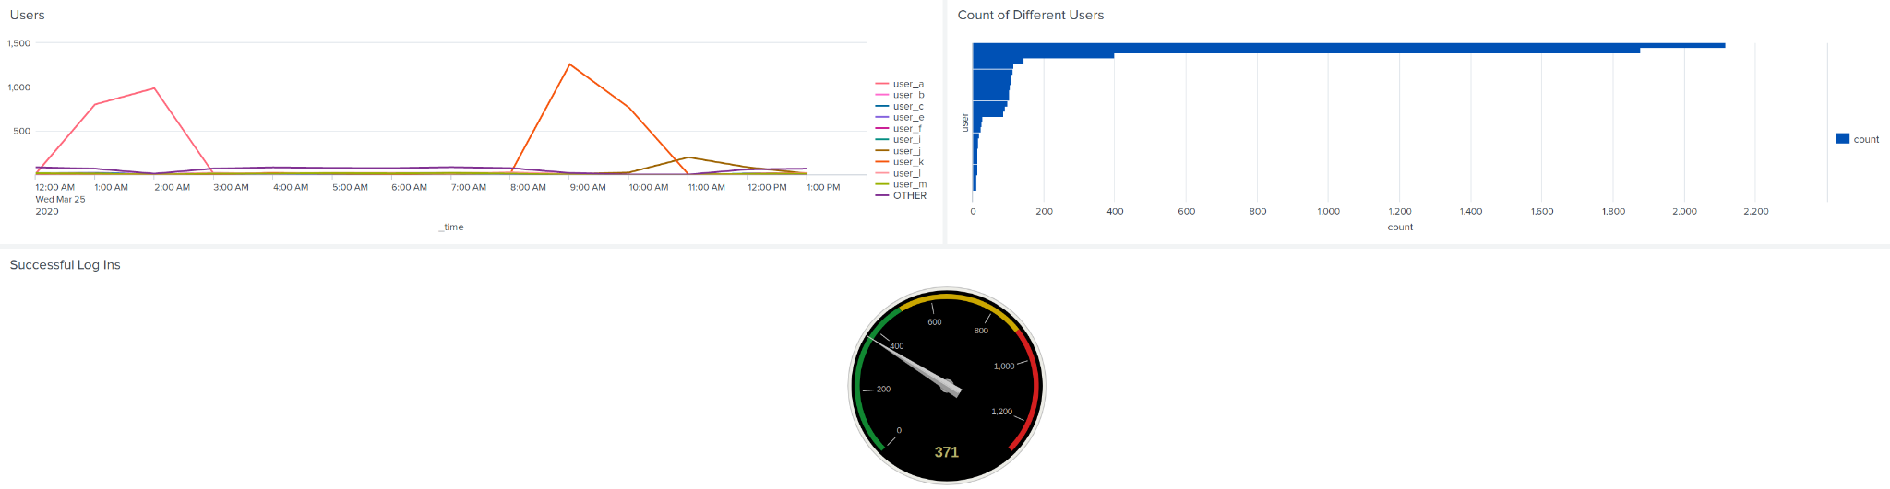
Dashboards—Windows(Suspected Attack Data)

Slide 20
Apache Logs
‹#›

Slide 21
Reports—Apache
Designed the following reports:
Report Name | Report Description
HTTP Methods | Types of HTTP activity being requested against VSI's web server
Top 10 Domains that refer to VSI Domain | Identifying suspicious referrers to VSI’s website
HTTP Response Code Count | To identity suspicious levels of HTTP responses

Slide 22
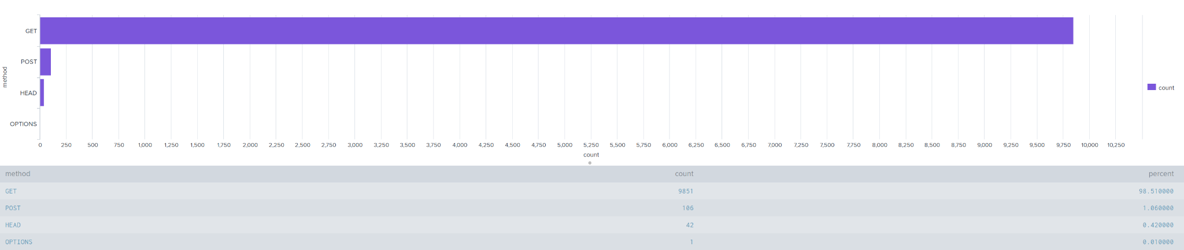
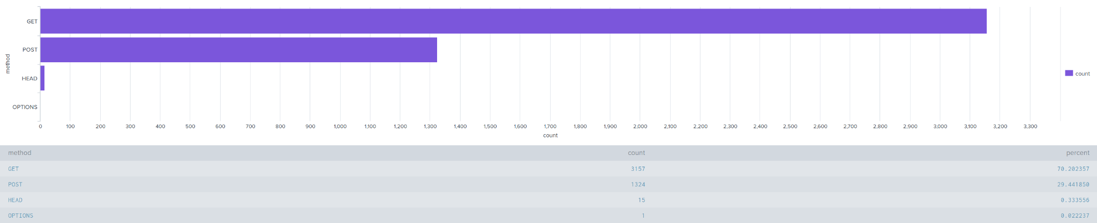
Images of Reports—Apache
HTTP Methods
Normal Data
HTTP Methods
Suspected Attack Data

Slide 23
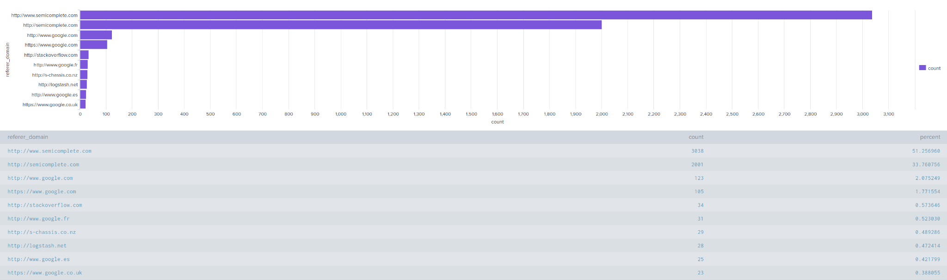
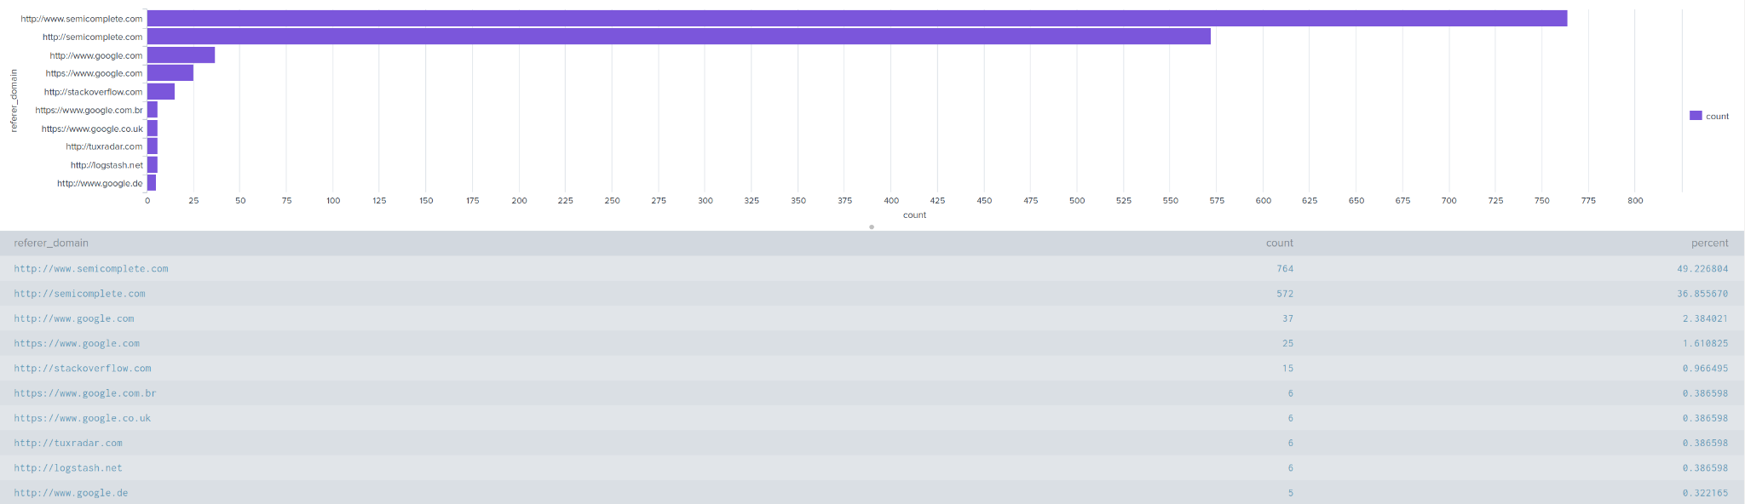
Images of Reports—Apache
Top 10 Domains That Refer To VSI
Normal Data
Top 10 Domains That Refer To VSI
Suspected Attack Data

Slide 24
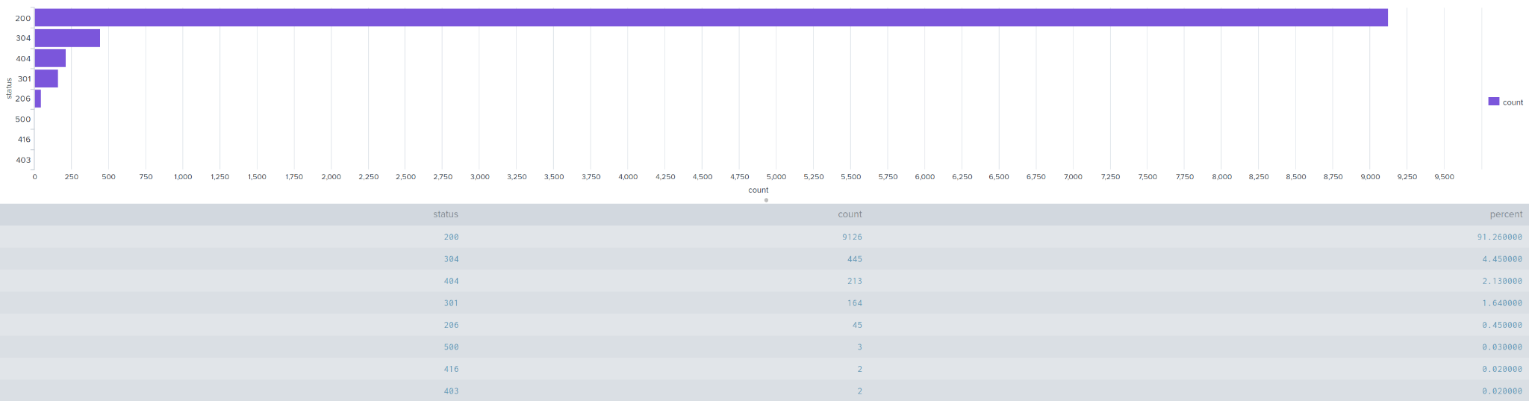
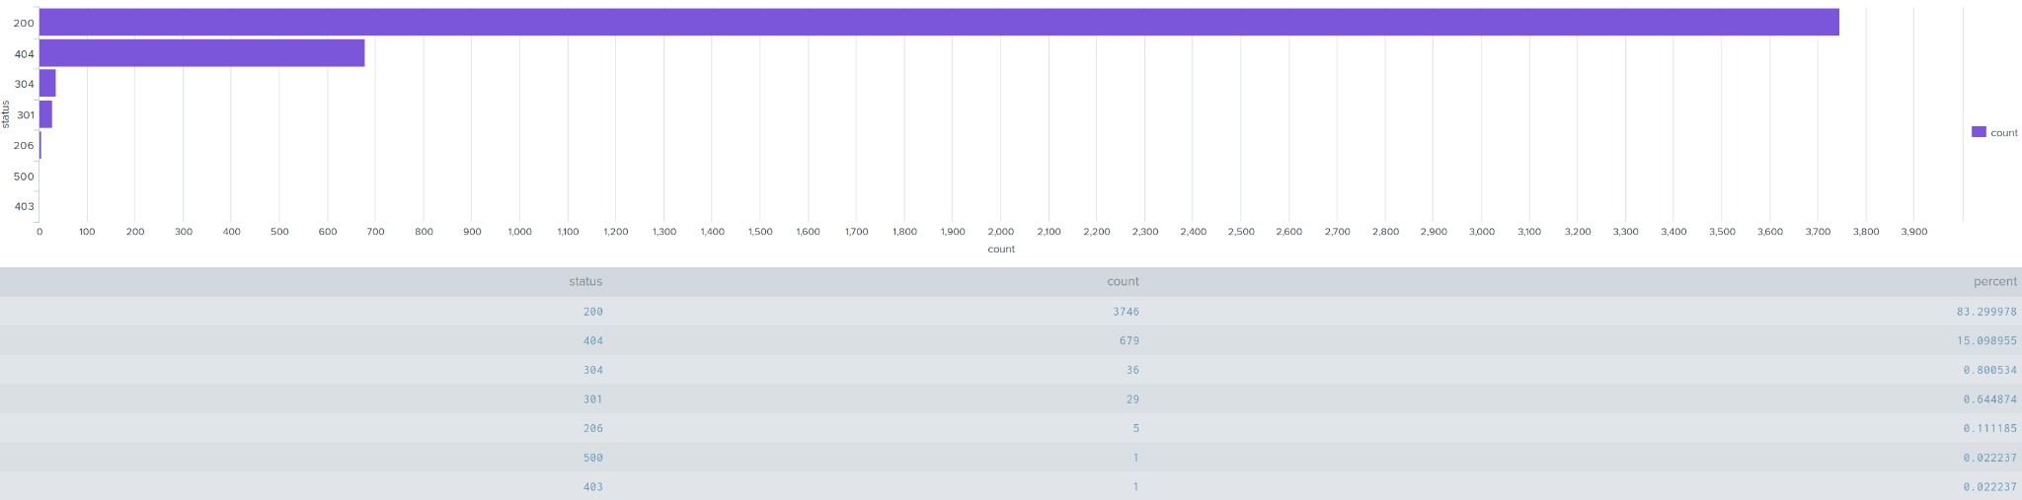
Images of Reports—Apache
HTTP Response Code Count
Normal Data
HTTP Response Code Count
Suspected Attack Data

Slide 25
Alerts—Apache
Designed the following alerts:
Alert Name | Alert Description | Alert Baseline | Alert Threshold
International Traffic (Excluding the USA) | This Alert will trigger when our system detects a high volume of International Traffic outside the United States within a 1 hour period. | 136 Events | Greater than 164 events within a 1 hour period.
JUSTIFICATION: [Explain the justification for your baselines and thresholds here.]

Slide 26
Alerts—Apache
Designed the following alerts:
Alert Name | Alert Description | Alert Baseline | Alert Threshold
High Volume of HTTP Post Methods | This Alert will trigger when our system detects a high volume of HTTP Post events within a 1 hour period. | No greater than 7 | Greater than 9 events within the hour.
After inspecting the baseline data for HTTP Post events, We found that the highest number of events was no greater than 7 events per hour, We feel a threshold of anything greater than 9 events within the hour to trigger an alert will be adequate.

Slide 27
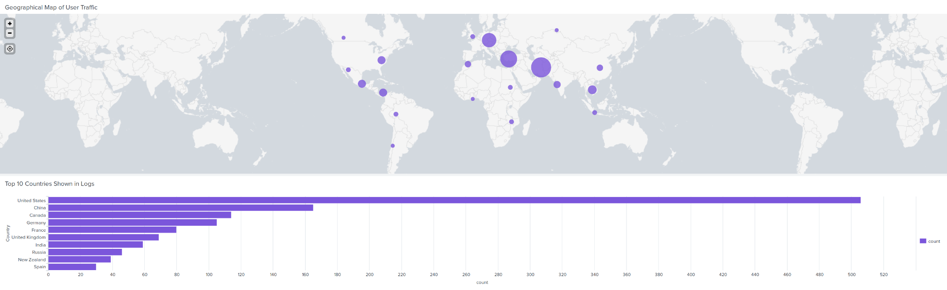
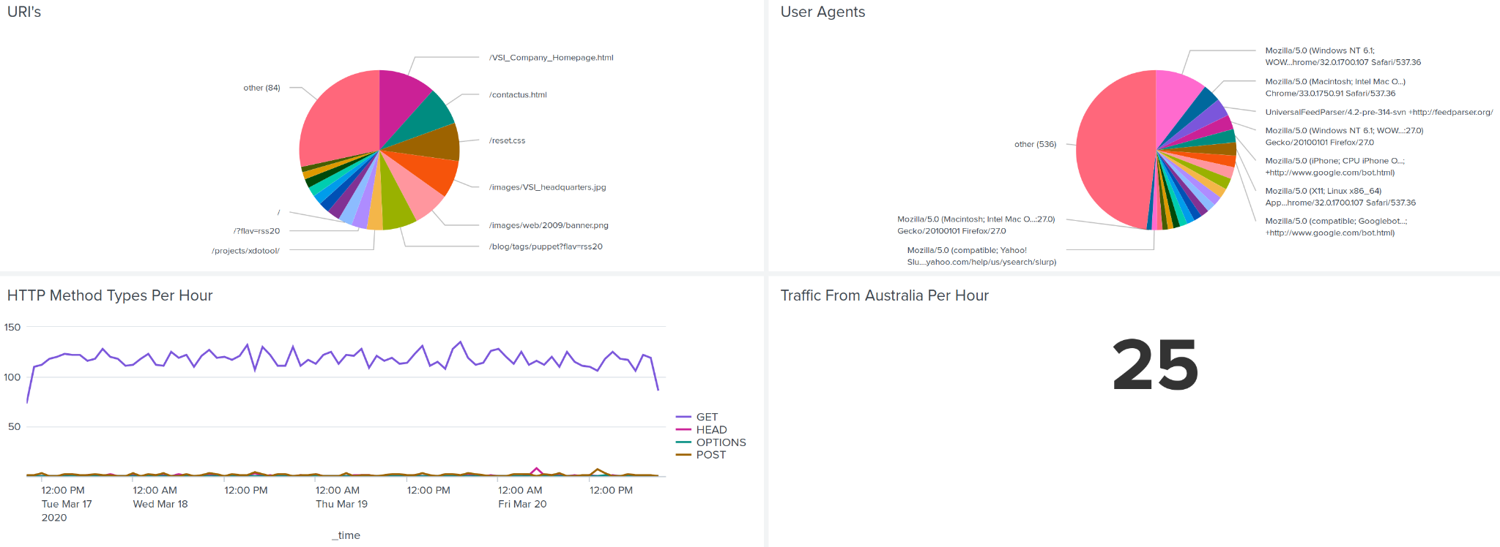
Dashboards—Apache(Normal Data)

Slide 28
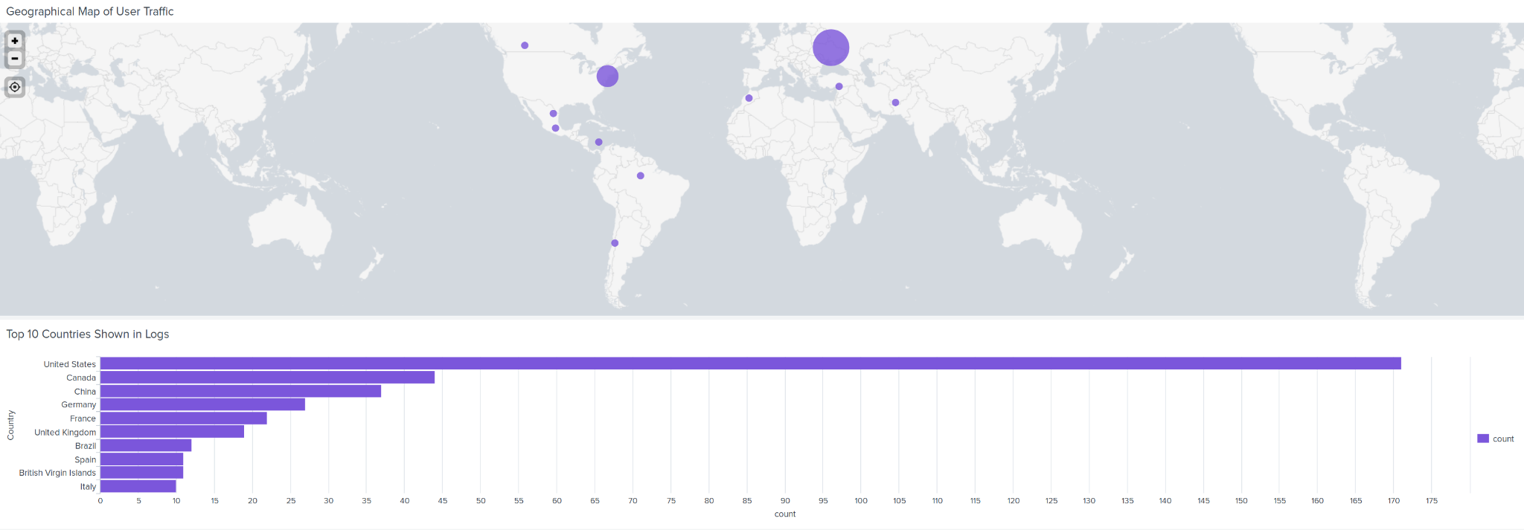
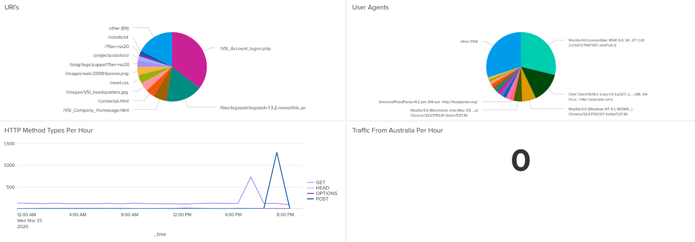
Dashboards—Apache(Suspected Attack Data)

Slide 29
Attack Analysis
‹#›

Slide 30
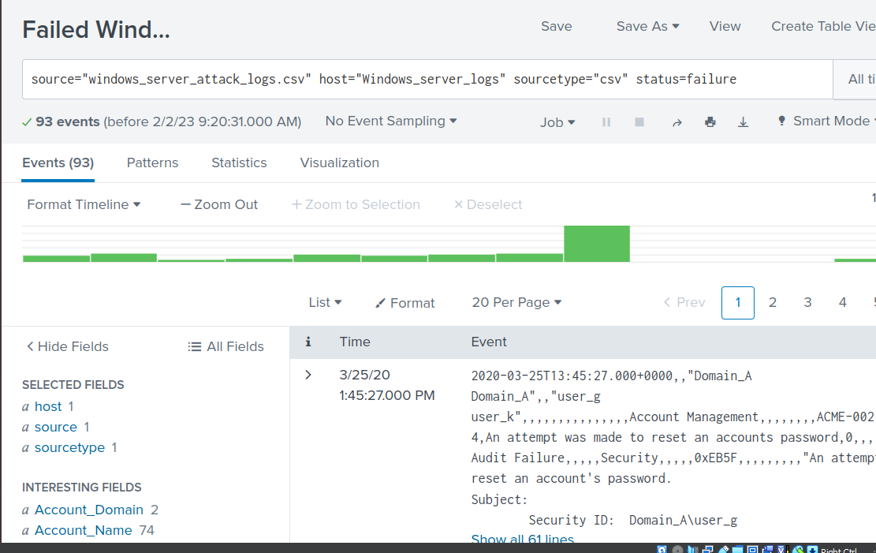
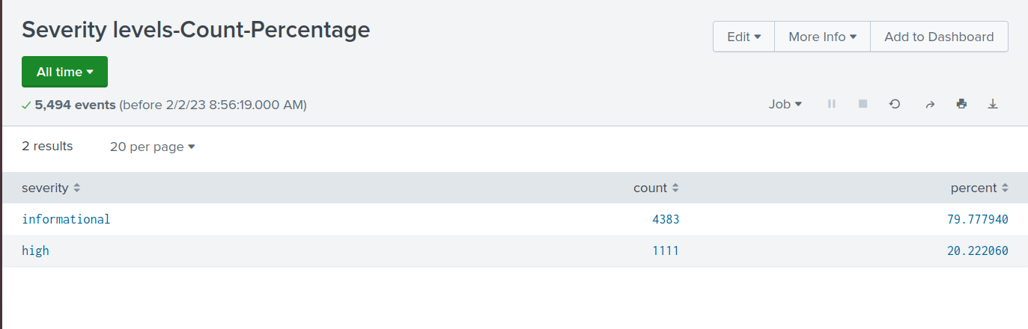
Attack Summary—Windows
Summarize your findings from your reports when analyzing the attack logs.
After analyzing the Severity Levels and Windows Activities events in the attack logs, we noticed a huge increase in the high severity and Success status’ categories.

Slide 31
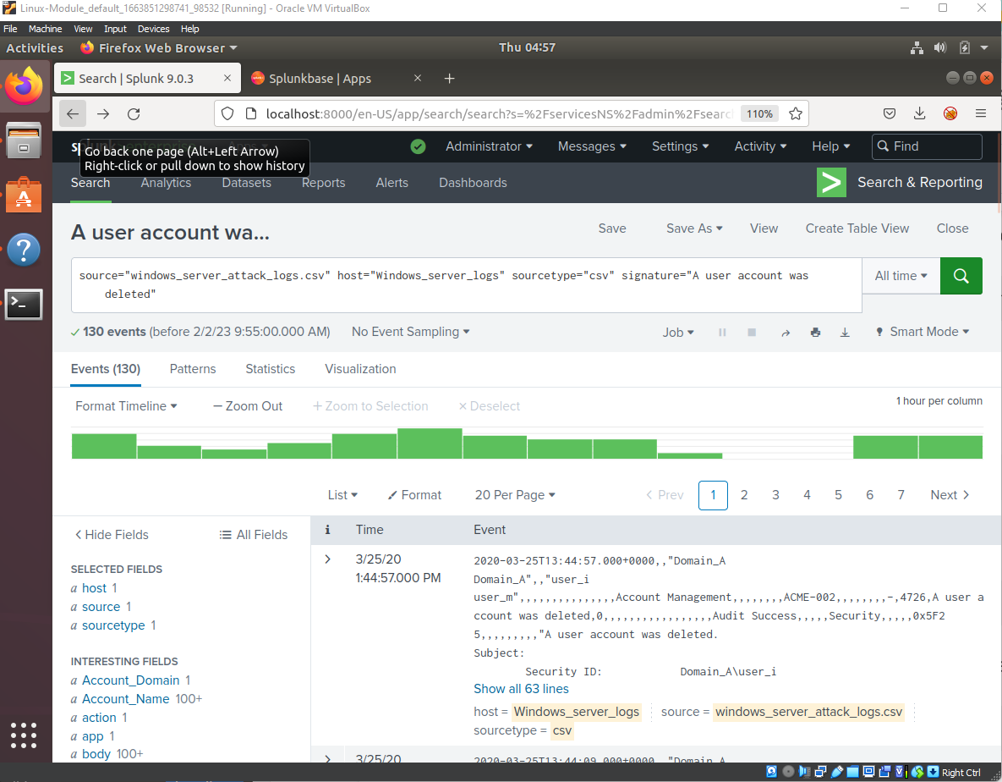
Attack Summary—Windows
Summarize your findings from your alerts when analyzing the attack logs. Were the thresholds correct?
After analysing our alerts from the attack logs for successful logins, failed windows activities and deleted accounts events
Alert Analysis for Successful Logins
Failed Windows Activity
Deleted Accounts

Slide 32
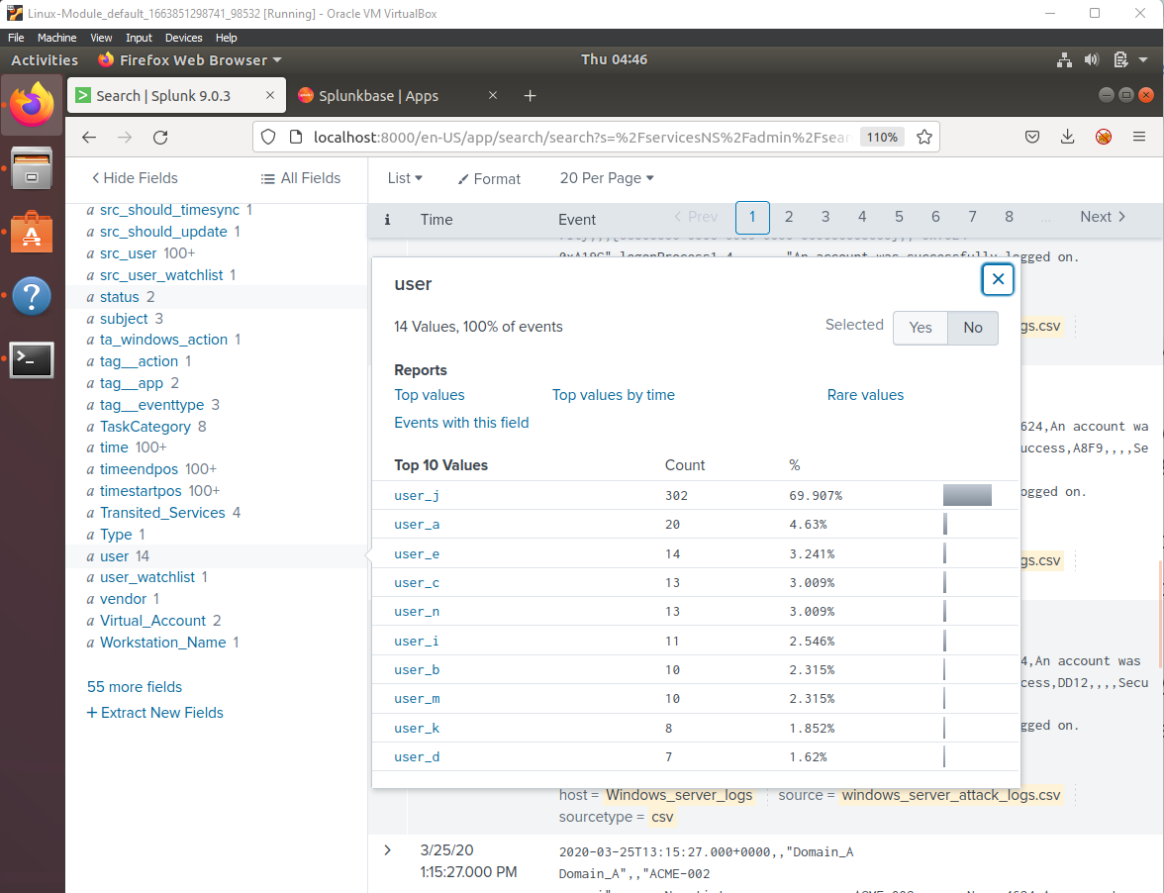
Attack Summary—Windows
Summarize your findings from your dashboards when analyzing the attack logs.

Slide 33
Screenshots of Attack Logs
[Optional: Place images that illustrate attack findings here.]

Slide 34
Attack Summary—Apache
Summarize your findings from your reports when analyzing the attack logs.
[Answer here]

Slide 35
Attack Summary—Apache
Summarize your findings from your alerts when analyzing the attack logs. Were the thresholds correct?
Yes they were, we had no issues with detecting suspicious events.

Slide 36
Attack Summary—Apache
Summarize your findings from your dashboards when analyzing the attack logs.
Between 5pm and 9pm on March 25th 2020 there was a large spike in GET & POST requests, with POST being most prevalent, peaking at 1296 requests in one hour. The number of POST requests was extremely high compared to normal activity.
We saw an unusually high amount of traffic from Ukraine to the apache server during

Slide 37
Screenshots of Attack Logs
[Optional: Place images that illustrate attack findings here.]

Slide 38
Summary and Future Mitigations
‹#›

Slide 39
Project 3 Summary
What were your overall findings from the attack that took place?
We believe that JobeCorp attempted a brute force attack on the login.php page of VSI Corp.
To prevent any further attack attempts of the same nature we recommend incorporating the following tools into the VSI infrastructure:
Use captchas: Add a captcha to the login page to ensure that only humans can perform login attempts
Two-Factor Authentication: Require a second authentication factor, such as a one-time code sent to a user's phone, to login.
Use SSL/TLS encryption: Use SSL/TLS encryption to secure communication between the client and server, making it difficult for attackers to intercept login credentials.
- Keep software up to date: Regularly update the software and libraries used by your login page to ensure that any known vulnerabilities are patched.

